Slide 1

Orientation to Computing-I
L T P :2 0 0
www.lpu.in Lovely Professional University
1

Slide 2

Unit-2 (Operating System)
Operating System: Operating Systems and its components, Windows Operating Systems Versions and features, Installation process, Directory Hierarchy of Windows Operating System (single level and multiple level), Bootloader
Linux Operating System: Linux OS and its features, Distribution versions, installation process, Directory Hierarchy of Linux System (single level and multiple level). Partitions: Understanding disk partitions and obtaining partition information using system tools, Comparison of windows and Linux OS, Virtual Machines
www.lpu.in Lovely Professional University
2

Slide 3
What is an Operating System?
What is an Operating system?
A program that acts as an intermediate/ interface between a user of a computer and the computer hardware.
Resource allocator (Managing the resources efficiently)
Control Program
Operating system goals:
Execute user programs and make problem solving easier.
Make the computer system convenient to use
Efficiently use available resources
An operating system is the one program that is running at all the times on the computer- usually called the kernel.
Kernel is a program that (allow) let the hardware to recognize and read the program/process.
www.lpu.in Lovely Professional University

Slide 4
Computer System Structure
Computer system can be divided into four components:
Hardware – provides basic computing resources
CPU, memory, I/O devices
Operating system
Controls and coordinates use of resources among various applications and users
System/Application programs – define the ways in which the system resources are used to solving user problems
Word processors, compilers, web browsers, database systems, video games
Users
People, machines, other computers
www.lpu.in Lovely Professional University

Slide 5
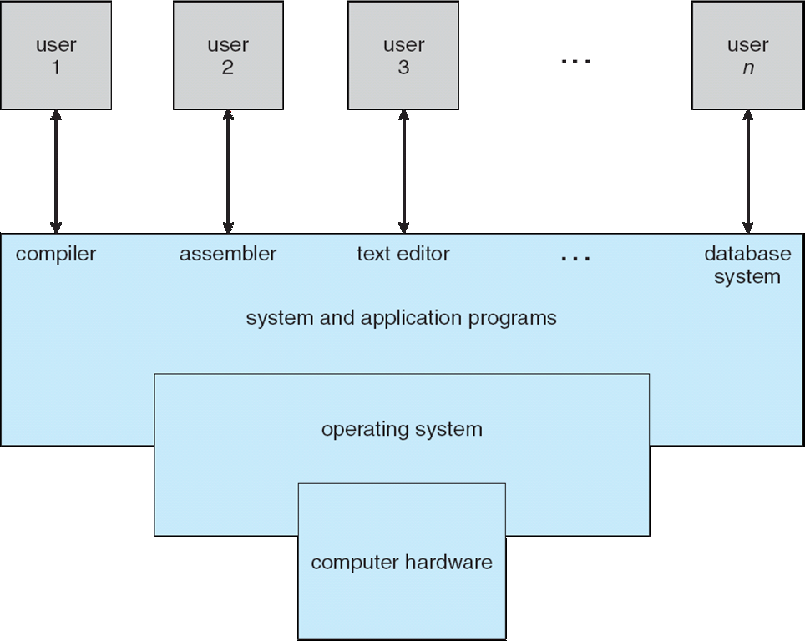
Four Components of a Computer System
www.lpu.in Lovely Professional University

Slide 6
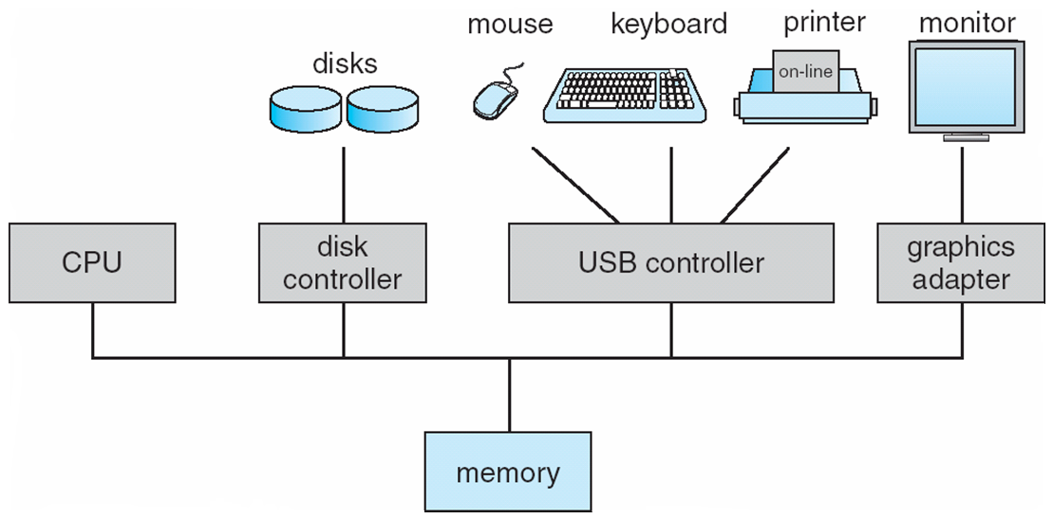
Computer System Organization
Computer-system operation
One or more CPUs, device controllers connect through common bus providing access to shared memory
Concurrent execution of CPUs and devices competing for memory cycles
www.lpu.in Lovely Professional University

Slide 7
Components of Operating System
Process Management
File Management
Network Management
Main Memory Management
Secondary Storage Management
I/O Device Management
Security Management
Command Interpreter System
www.lpu.in Lovely Professional University
7

Slide 8
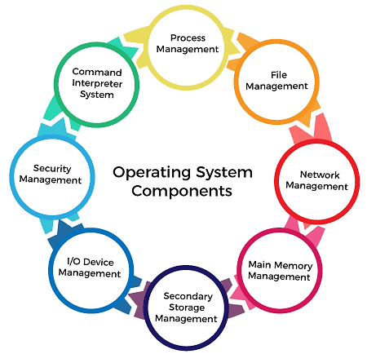
www.lpu.in Lovely Professional University
8

Slide 9
Process Management
The process management component is a procedure for managing many processes running simultaneously on the operating system. Every running software application program has one or more processes associated with them.
For example, when you use a search engine like Chrome, there is a process running for that browser program.
Process management keeps processes running efficiently. It also uses memory allocated to them and shutting them down when needed.
The execution of a process must be sequential so, at least one instruction should be executed on behalf of the process.
www.lpu.in Lovely Professional University
9

Slide 10
Functions of process management
Here are the following functions of process management in the operating system, such as:
Process creation and deletion.
Suspension and resumption.
Synchronization process
Communication process
www.lpu.in Lovely Professional University
10

Slide 11
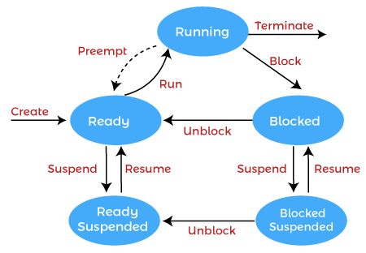
www.lpu.in Lovely Professional University
11

Slide 12
File Management
A file is a set of related information defined by its creator. It commonly represents programs (both source and object forms) and data. Data files can be alphabetic, numeric, or alphanumeric.
Function of file management
The operating system has the following important activities in connection with file management:
File and directory creation and deletion.
For manipulating files and directories.
Mapping files onto secondary storage.
Backup files on stable storage media.
www.lpu.in Lovely Professional University
12

Slide 13
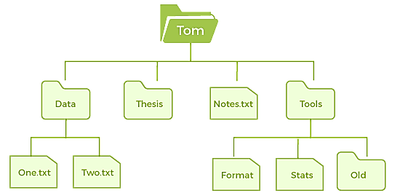
www.lpu.in Lovely Professional University
13

Slide 14
Network Management
Network management is the process of administering and managing computer networks. It includes performance management, provisioning of networks, fault analysis, and maintaining the quality of service.
A distributed system is a collection of computers or processors that never share their memory and clock.
In this type of system, all the processors have their local memory, and the processors communicate with each other using different communication cables, such as fibre optics or telephone lines.
The computers in the network are connected through a communication network, which can configure in many different ways.
The network can fully or partially connect in network management, which helps users design routing and connection strategies that overcome connection and security issues.
www.lpu.in Lovely Professional University
14

Slide 15
Functions of Network management
Distributed systems help you to various computing resources in size and function. They may involve minicomputers, microprocessors, and many general-purpose computer systems.
A distributed system also offers the user access to the various resources the network shares.
It helps to access shared resources that help computation to speed up or offers data availability and reliability.
www.lpu.in Lovely Professional University
15

Slide 16
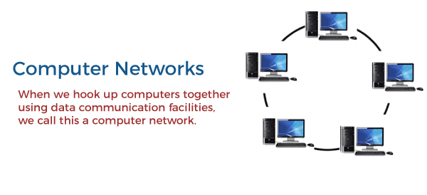
www.lpu.in Lovely Professional University
16

Slide 17
Main Memory management
Main memory is a large array of storage or bytes, which has an address.
The memory management process is conducted by using a sequence of reads or writes of specific memory addresses.
It should be mapped to absolute addresses and loaded inside the memory to execute a program. The selection of a memory management method depends on several factors
However, it is mainly based on the hardware design of the system. Each algorithm requires corresponding hardware support.
Main memory offers fast storage that can be accessed directly by the CPU. It is costly and hence has a lower storage capacity. However, for a program to be executed, it must be in the main memory.
www.lpu.in Lovely Professional University
17

Slide 18
Functions of Memory management
An Operating System performs the following functions for Memory Management in the operating system:
It helps you to keep track of primary memory.
Determine what part of it are in use by whom, what part is not in use.
In a multiprogramming system, the OS decides which process will get memory and how much.
Allocates the memory when a process requests.
It also de-allocates the memory when a process no longer requires or has been terminated.
www.lpu.in Lovely Professional University
18

Slide 19
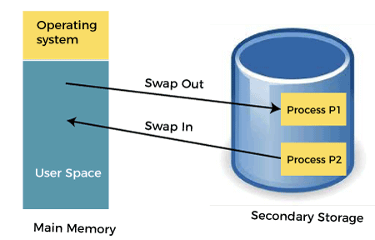
www.lpu.in Lovely Professional University
19

Slide 20
Secondary-Storage Management
The most important task of a computer system is to execute programs. These programs help you to access the data from the main memory during execution.
This memory of the computer is very small to store all data and programs permanently. The computer system offers secondary storage to back up the main memory.
Today modern computers use hard drives/SSD as the primary storage of both programs and data.
However, the secondary storage management also works with storage devices, such as USB flash drives and CD/DVD drives.
Programs like assemblers and compilers are stored on the disk until it is loaded into memory, and then use the disk is used as a source and destination for processing.
www.lpu.in Lovely Professional University
20

Slide 21
Functions of Secondary storage management
Here are some major functions of secondary storage management in the operating system:
Storage allocation
Free space management
Disk scheduling
www.lpu.in Lovely Professional University
21

Slide 22
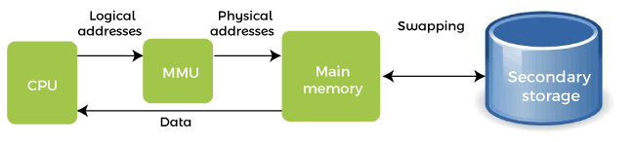
www.lpu.in Lovely Professional University
22

Slide 23
I/O Device Management
One of the important use of an operating system that helps to hide the variations of specific hardware devices from the user.
Functions of I/O management
The I/O management system offers the following functions, such as:
It offers a buffer caching system
It provides general device driver code
It provides drivers for particular hardware devices.
I/O helps you to know the individualities of a specific device.
www.lpu.in Lovely Professional University
23

Slide 24
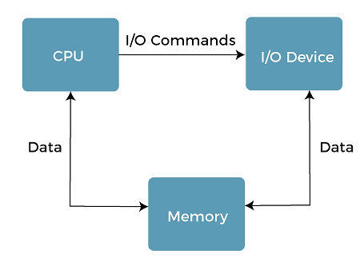
www.lpu.in Lovely Professional University
24

Slide 25
Security Management
The various processes in an operating system need to be secured from other activities.
Therefore, various mechanisms can ensure those processes that want to operate files, memory CPU, and other hardware resources should have proper authorization from the operating system.
Security refers to a mechanism for controlling the access of programs, processes, or users to the resources defined by computer controls to be imposed, together with some means of enforcement.
For example, memory addressing hardware helps to confirm that a process can be executed within its own address space.
The time ensures that no process has control of the CPU without renouncing it.
www.lpu.in Lovely Professional University
25

Slide 26
Security Management
No process is allowed to do its own I/O to protect, which helps you to keep the integrity of the various peripheral devices.
Security can improve reliability by detecting latent errors at the interfaces between component subsystems.
Early detection of interface errors can prevent the foulness of a healthy subsystem by a malfunctioning subsystem.
An unprotected resource cannot misuse by an unauthorized or incompetent user.
www.lpu.in Lovely Professional University
26

Slide 27
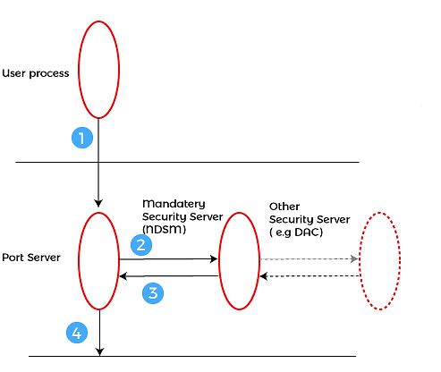
www.lpu.in Lovely Professional University
27

Slide 28
Command Interpreter System
One of the most important components of an operating system is its command interpreter. The command interpreter is the primary interface between the user and the rest of the system.
Many commands are given to the operating system by control statements. A program that reads and interprets control statements is automatically executed when a new job is started in a batch system or a user logs in to a time-shared system. This program is variously called:
The control card interpreter,
The command-line interpreter,
The shell (in UNIX), and so on.
Its function is quite simple, get the next command statement, and execute it. The command statements deal with process management, I/O handling, secondary storage management, main memory management, file system access, protection, and networking.
www.lpu.in Lovely Professional University
28

Slide 29
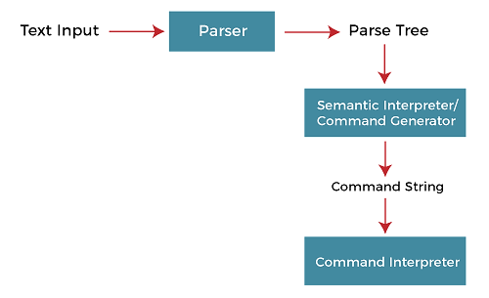
www.lpu.in Lovely Professional University
29

Slide 30
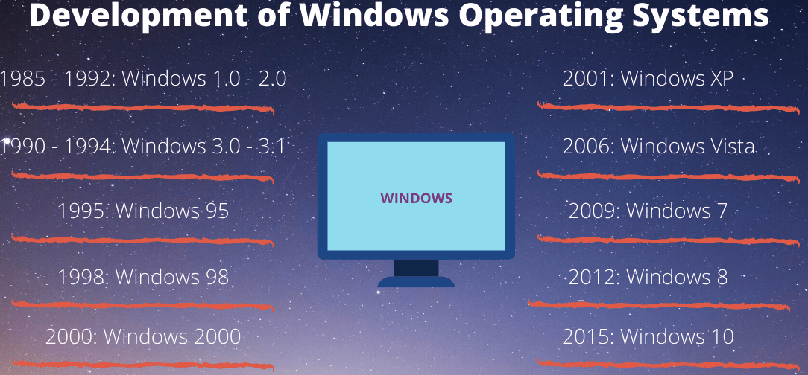
Windows Operating Systems Versions and features
www.lpu.in Lovely Professional University
30

Slide 31
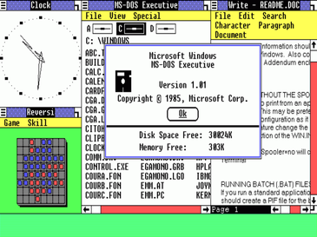
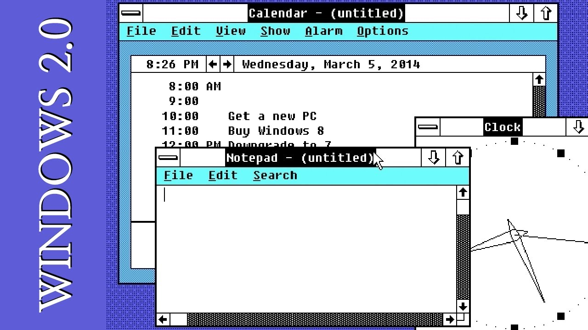
1. Windows 1.0
It was released on November 20, 1985
Pure Operating Environment
Used Graphical User Interface
Simple Graphics
Offered limited multi-tasking was expected to have a better future potential
2. Windows 2.0
It was released on December 9, 1987
16-bit Graphic User Interface (GUI) based operating environment
Introduced Control Panel, and the first version of MS Word and Excel
Unlike Windows 1.0, it had the capacity to allow applications to overlap each other
It was also the last Windows OS which did not require a hard disk
Hardware played an important role
www.lpu.in Lovely Professional University
31

Slide 32
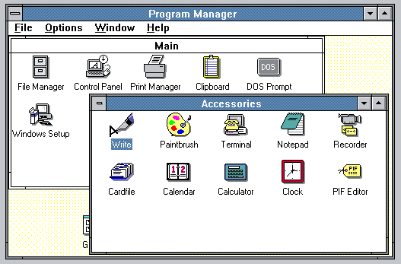
3. Windows 3.0
It was released in 1990
It was better at multitasking
Used 8086 microprocessors
It has both, conventional and extendable memory
First version of Windows to gather critical appreciation
Better memory/ storage
Note* – None of the above-mentioned Windows was Operating System. They all came under the category of Windows, working based on a graphical operating environment. It was Windows 95, which was the first Operating System released by Microsoft.
www.lpu.in Lovely Professional University
32

Slide 33
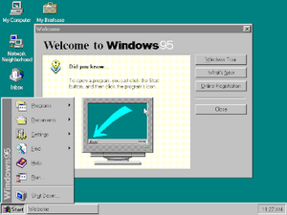
4. Window 95
It was the first complete Operating System
It was released on August 15, 1995
It merged MS-DOS and Windows products
It simplified plug-and-play features
Taskbar and Start menu was introduced with this Windows OS
Advanced from 16-bit GUI to 32-bit GUI
Long file names could be saved
Initially, computers with Windows 95 did not have Internet Explorer installed but by the release date of Windows 95, the first version of Internet Explorer was installed in the software
On December 31, 2001, Windows declared this version of OS outdated and ended its support for the same
www.lpu.in Lovely Professional University
33

Slide 34
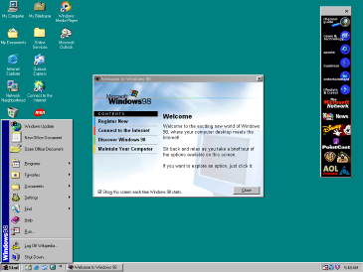
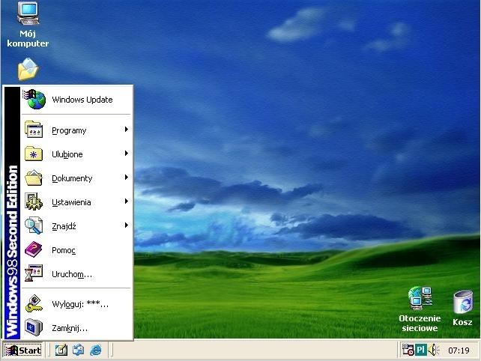
5. Windows 98
It was released to manufacturing on May 15, 1998
It was a 16-bit and 32-bit product based on MS-DOS
It was not an entirely new version but just a tuned-up version of Windows 95
Internet Explorer 4.01 was released along with this Windows version
It did not support USB printers or mass-storage devices
An update to this version “Windows SE” was released in 1999
www.lpu.in Lovely Professional University
34

Slide 35
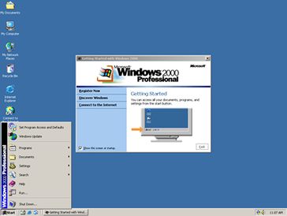
6. Windows 2000
It was officially released on February 17, 2000. However, its manufacturing had begun in late 1999
A core set of features was followed for manufacturing Windows 2000 but 4 different editions, targeting different sectors of the market were released. These included: Server, Professional, Advanced Server and Datacenter Server
It was considered one of the most secure OS ever
A local disk manager was introduced with these Windows
Multilingual User Interface – it supports many different languages
www.lpu.in Lovely Professional University
35

Slide 36
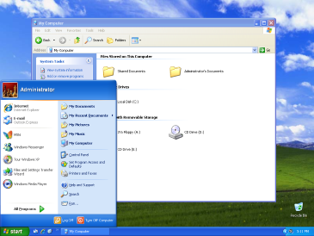
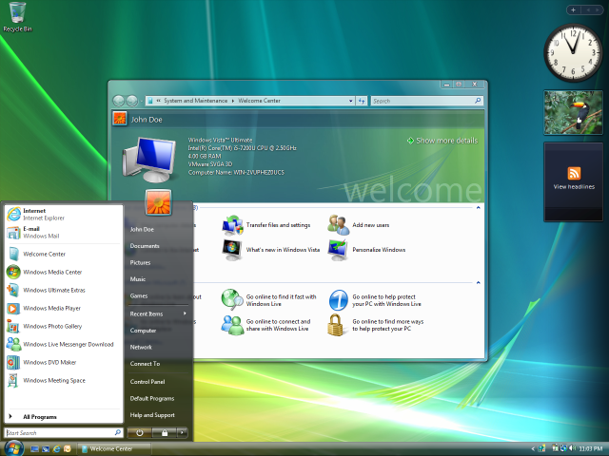
7. Windows XP
While the manufacturing started on August 24, 2001, the official product was released on October 25, 2001
Advanced portable PC support
Automatic wireless connection support
Fast start-up
Better Graphical User Interface (GUI)
Help and support center
8. Windows Vista
It was released on January 30, 2007
It had an upgraded version of Graphical User Interface
It was the first operating system to use DVD-ROM for installation
www.lpu.in Lovely Professional University
36

Slide 37
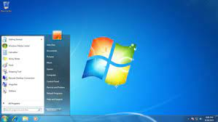
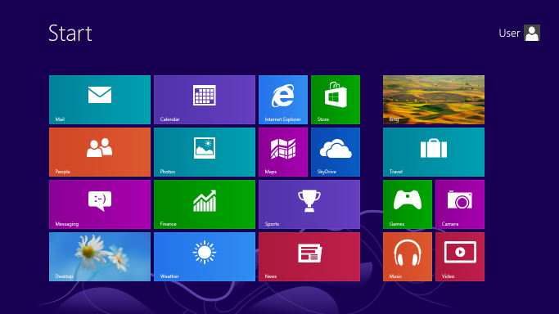
9. Windows 7
It was released on October 22, 2009
A large number of new features were introduced
Redesigned Windows shell with an updated taskbar
incremental upgrade to the Windows line
Libraries were added in the file management system
A few features from the past Windows were removed
Extended hardware support
10. Windows 8
It was released for retail on October 26, 2012
Optimizations for touch-based. Installed in new devices like Laptops, Mobile phones, tablets, etc.
Increased integration with cloud services. Windows Store service for software distribution. The task manager had been redesigned
New security features were introduced
Online Applications could be directly downloaded
www.lpu.in Lovely Professional University
37

Slide 38
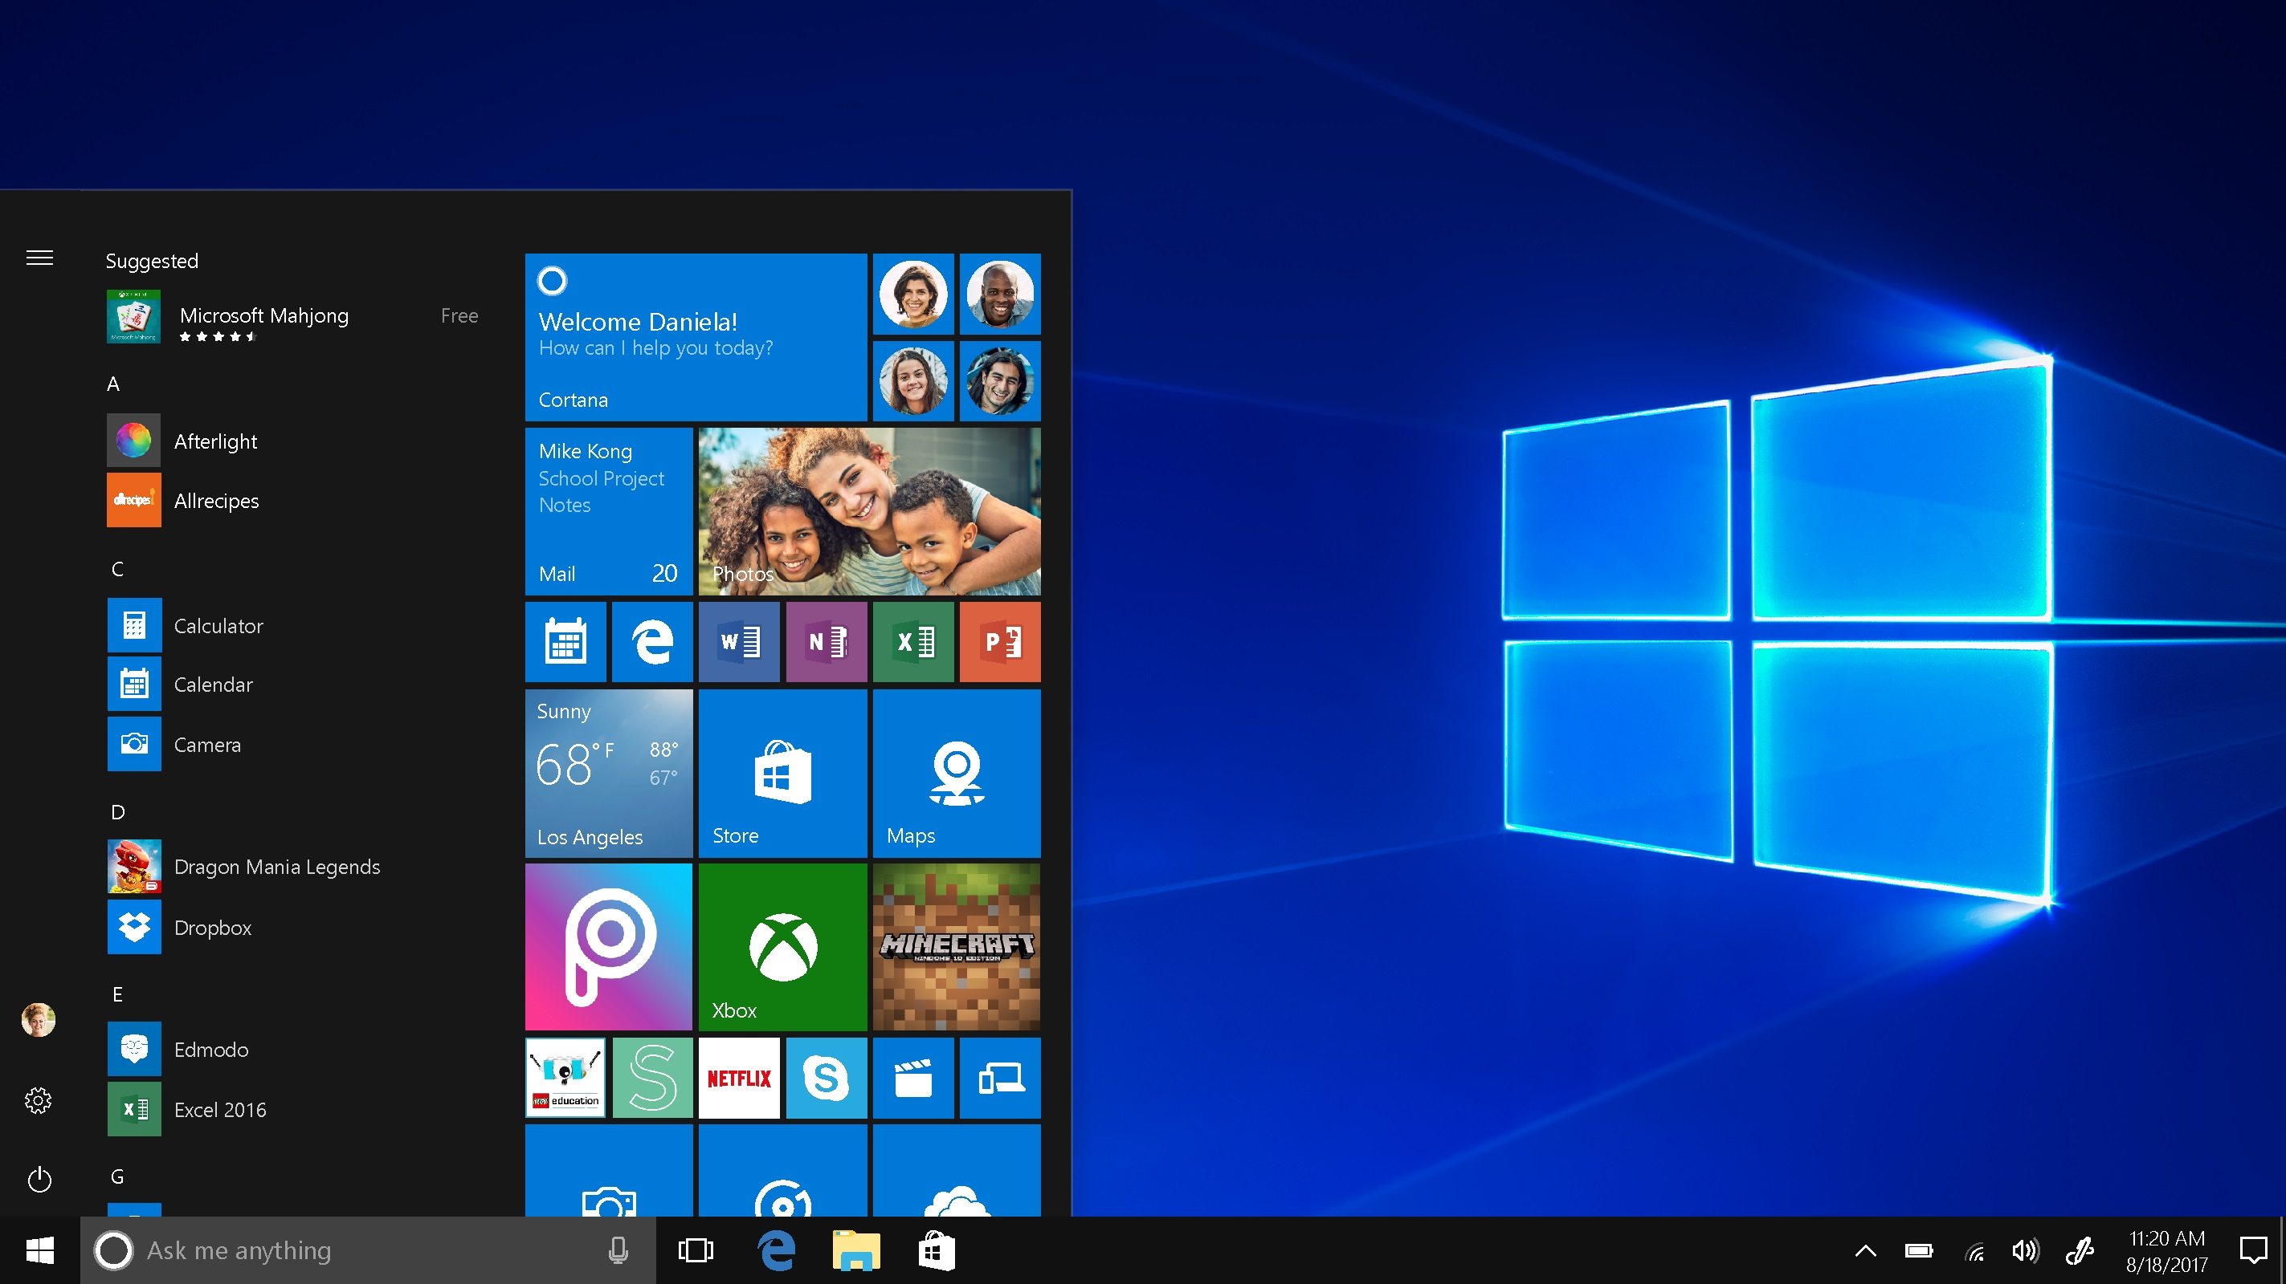
11. Windows 10
It was released on July 29, 2015
Addresses shortcomings in the user interface first introduced with Windows 8
A virtual desktop system
It had the ability to run Windows Store apps within Windows on the desktop rather than in the full-screen mode
Included new icons
To reduce storage shortcomings, Windows 10 automatically compresses the file size
www.lpu.in Lovely Professional University
38

Slide 39
Installation process
Set up the display environment
Erase the primary boot disk
Set up the BIOS
Install the operating system
Install the operating system, update the drivers, and run operating system updates, as necessary.
www.lpu.in Lovely Professional University
39
Notes:
https://www.computerhope.com/issues/ch001838.htm
https://www.wikihow.com/Install-Windows-10
39

Slide 40
Directory Structure
Symbol table of files that stores all related information about a file it holds with its contents
Directory
F 1
F 2
F 3
F 4
F n
Files
Both the directory structure and the files reside on disk
Backups of these two structures are kept on tapes
www.lpu.in Lovely Professional University
Notes:
40

Slide 41
Operations Performed on Directory
Directory: collection of files or directories
A Symbol Table that translates file names into their directory entry.
Operations:
Search for a file
Create a file
Delete a file
List a directory
Rename a file
Traverse the file system : Search all directories/ sub directories and files
www.lpu.in Lovely Professional University
Notes:
41
41

Slide 42
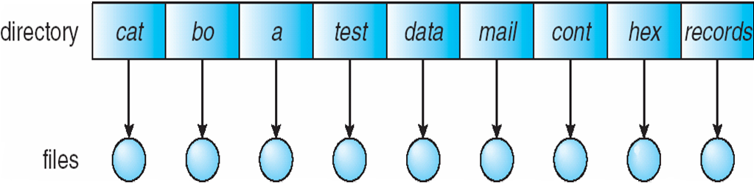
Directory Schemes
Single Level Directory
One directory many files
Single-Level Directory
Easy to support and understand.
Limitation:
When number of files increases or when the system has more than one user, then Naming problem occurs. All files should have unique names.
Disadvantage:
Difficult to remember the name of files when files increases
Single directory for all users
File names created by different users should be different.
www.lpu.in Lovely Professional University
Notes:
42
42

Slide 43
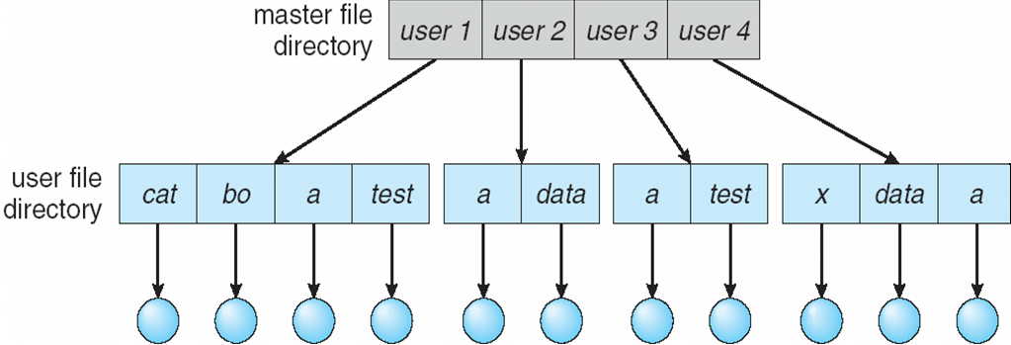
Two Level
2. Two level directory, each user has his own user file directory(UFD).
UFDs have the similar structure, but each lists files of a single user.
www.lpu.in Lovely Professional University
Notes:
43
43

Slide 44
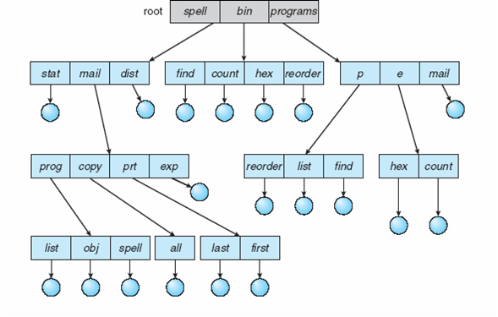
Tree Structure
Users can create their sub directories to manage the files.
Three has Root directory and files have unique file names
www.lpu.in Lovely Professional University
Notes:
44
44

Slide 45
Acyclic-Graph Directories
Multiple users can Have shared subdirectories and files
Users have their own working directory and may have one shared directory
Shared subdirectory created by one user in one directory is automatically visible to all users sharing that directory.
Shared directory or file may exist at multiple places simultaneously
Because of sharing, a file may have multiple absolute paths
So different names can refer to same file
www.lpu.in Lovely Professional University
Notes:
45
45

Slide 46
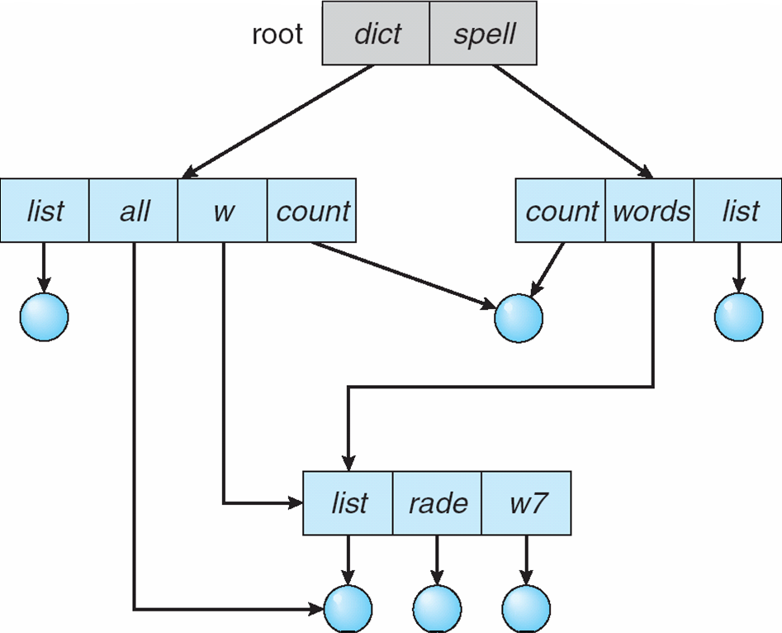
Acyclic-Graph Directories
www.lpu.in Lovely Professional University
Notes:
46
46

Slide 47
General Graph Directories
Created by adding links to the existing directory
Allows cycles in the same directory
As all files are dependent / linked deleting a main file may harm other files
In case of deletion: Garbage Collection is used
In First Pass: Traversing the entire file and marking everything that can be accessed
In Second Pass: Collect everything that is not marked as the free space
www.lpu.in Lovely Professional University
Notes:
47

Slide 48
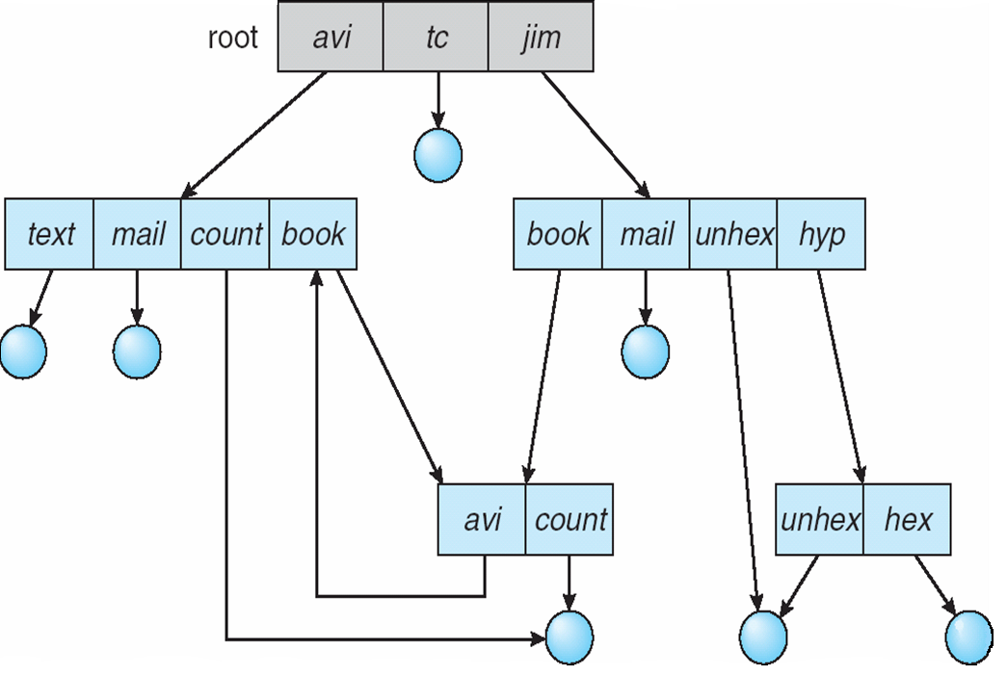
General Graph Directories
There can be cycle in the directory arrangement
General Graph Directory
www.lpu.in Lovely Professional University
Notes:
48
48

Slide 49
Directory Implementation
Directories need to be fast to search, insert, and delete, with a minimum of wasted disk space.
1 Linear List
A linear list is the simplest and easiest directory structure
Finding a file requires a linear search.
Deletions can be done by moving all or one entry to vacant position and deleting the pointer.
2 Hash Table
A hash table can also be used to speed up searches.
Implementation is by using Hash value.
(Division/Variant Method)
www.lpu.in Lovely Professional University
Notes:
49
49

Slide 50
Bootloader
A boot loader, also called a boot manager, is a small program that places the operating system (OS) of a computer into memory.
When a computer is powered-up or restarted, the basic input/output system (BIOS) performs some initial tests, and then transfers control to the Master Boot Record (MBR) where the boot loader resides.
Most new computers are shipped with boot loaders for some version of Microsoft Windows or the Mac OS.
If a computer is to be used with Linux, a special boot loader must be installed.
www.lpu.in Lovely Professional University
50
Notes:
50

Slide 51
Bootloader
The two most common boot loaders are known as:
LILO (LInux LOader) and
LOADLIN (LOAD LINux).
An alternative bootloader, called GRUB (GRand Unified Bootloader), is used with Red Hat Linux.
LILO is the most popular boot loader among computer users that employs Linux as the main, or only, operating system.
www.lpu.in Lovely Professional University
51
Notes:
51

Slide 52
Bootloader
LOADLIN is preferred by some users whose computers have multiple operating systems, and who spend relatively little time in Linux.
LOADLIN is sometimes used as a backup boot loader for Linux in case LILO fails.
GRUB is preferred by many users of Red Hat Linux, because it is the default boot loader for that distribution.
www.lpu.in Lovely Professional University
52
Notes:
52

Slide 53
File system management
File system management :
File system basics, Types of file systems( FAT, GFT, HFS, NDFS, UDF, Extended file systems), Pipes and redirection, Searching the file system using find and grep with simple regular expressions, Basic process control using signals, pausing and resuming process from a Linux terminal, terminating a process, Adding/removing from search path using PATH variable.
Other Shell commands:
ls, cat, man, cd, touch, cp, mv, rmdir, mkdir, rm, chmod, pwd, ps, kill, etc, Kernel and types of kernels.
www.lpu.in Lovely Professional University
53

Slide 54
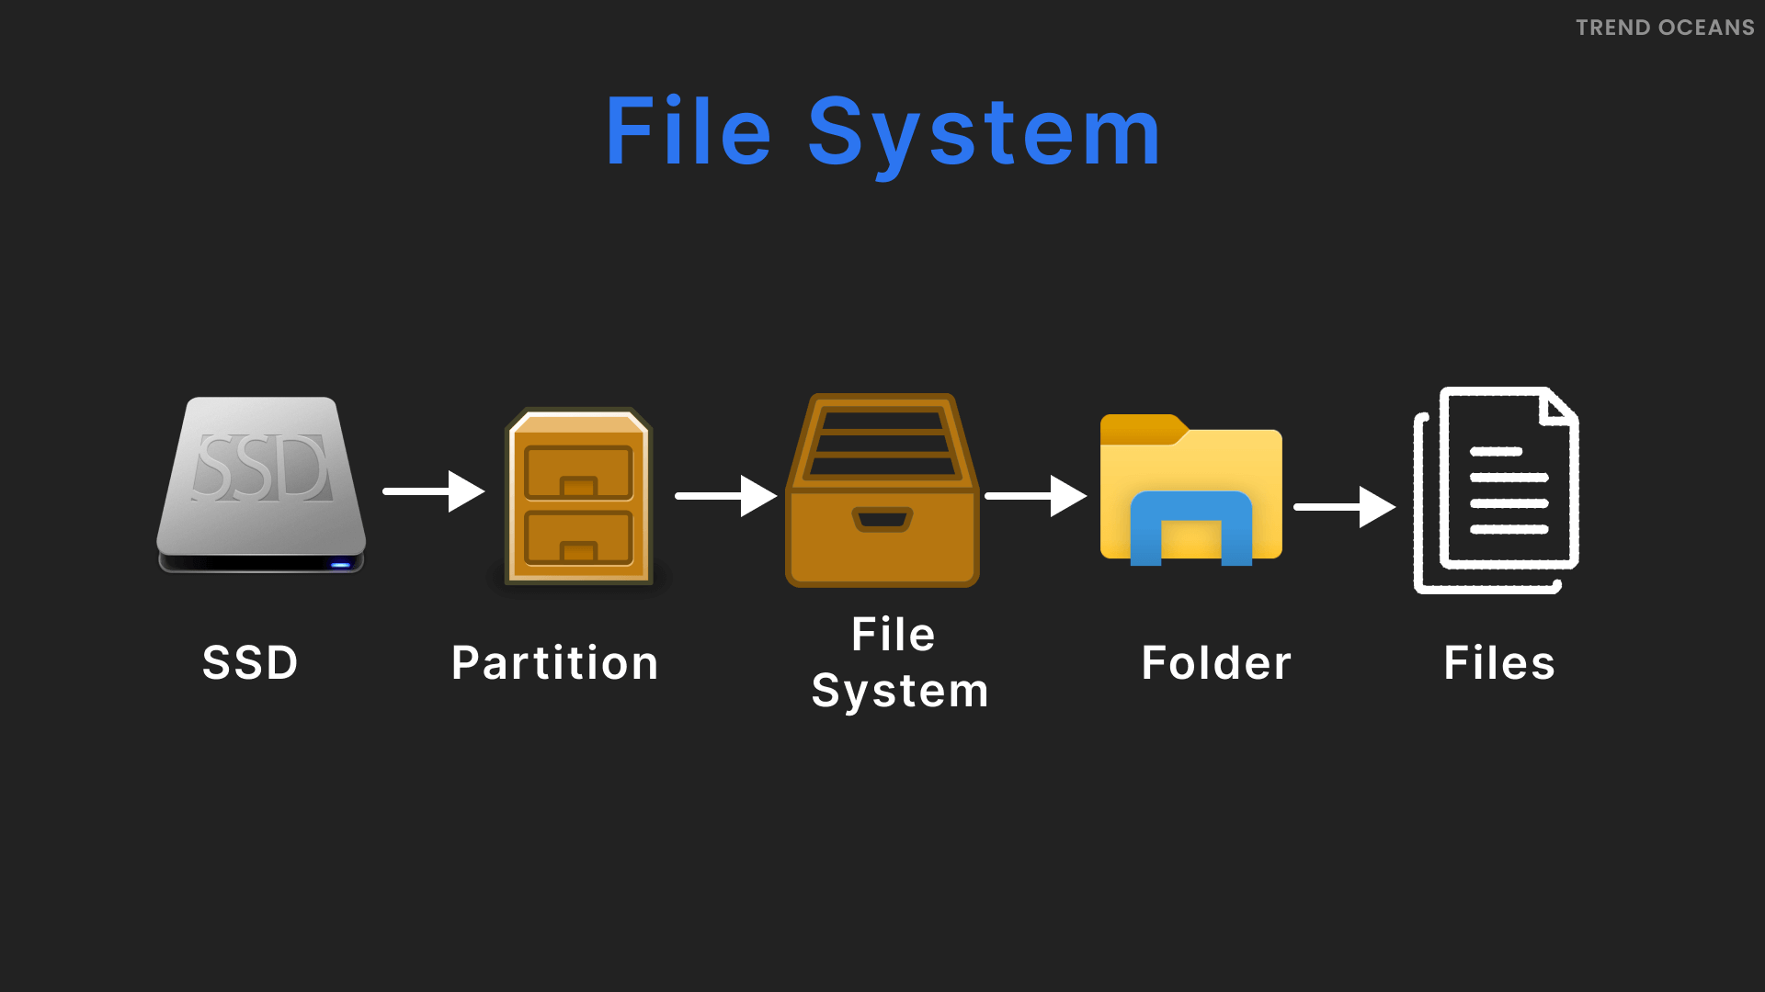
Understanding File System
File system is a structure used to organize data and programs on computer storage devices.
It keeps track of the physical locations of all data elements on disk and allows users to quickly and reliably retrieve files when needed.
Every operating system, from MS-DOS to Windows 95, Windows XP and Linux, has its own file system.
www.lpu.in Lovely Professional University
54

Slide 55
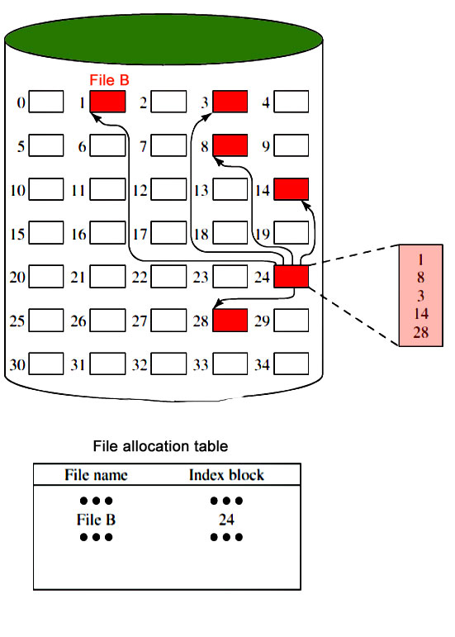
Representation of File System
www.lpu.in Lovely Professional University
55

Slide 56
File can be..
Regular files
Directory Files
Device Files or Special Files
Regular Files stores data (text, binary, and executable)
Directory files contains information used to access other files.
Device Files defines a FIFO (first-in, first-out) pipe file or a physical device
www.lpu.in Lovely Professional University
56

Slide 57
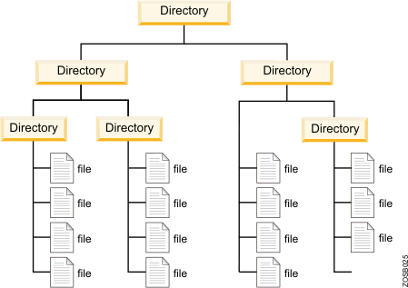
File System Representation
www.lpu.in Lovely Professional University
57

Slide 58
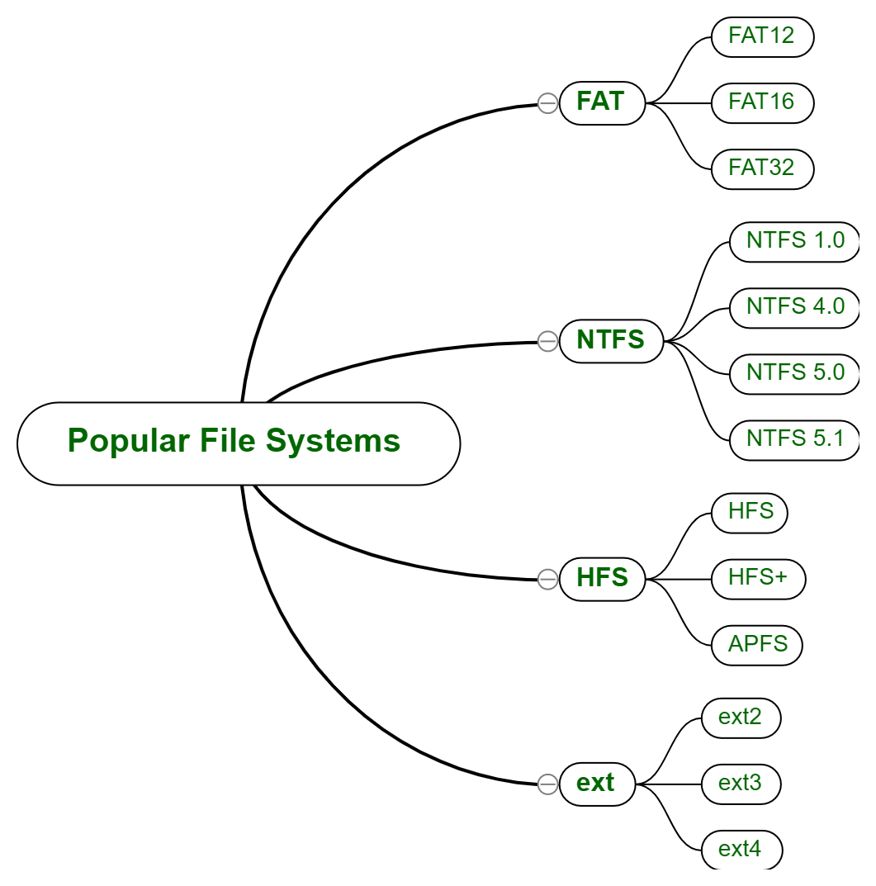
Popular File System
www.lpu.in Lovely Professional University
58

Slide 59
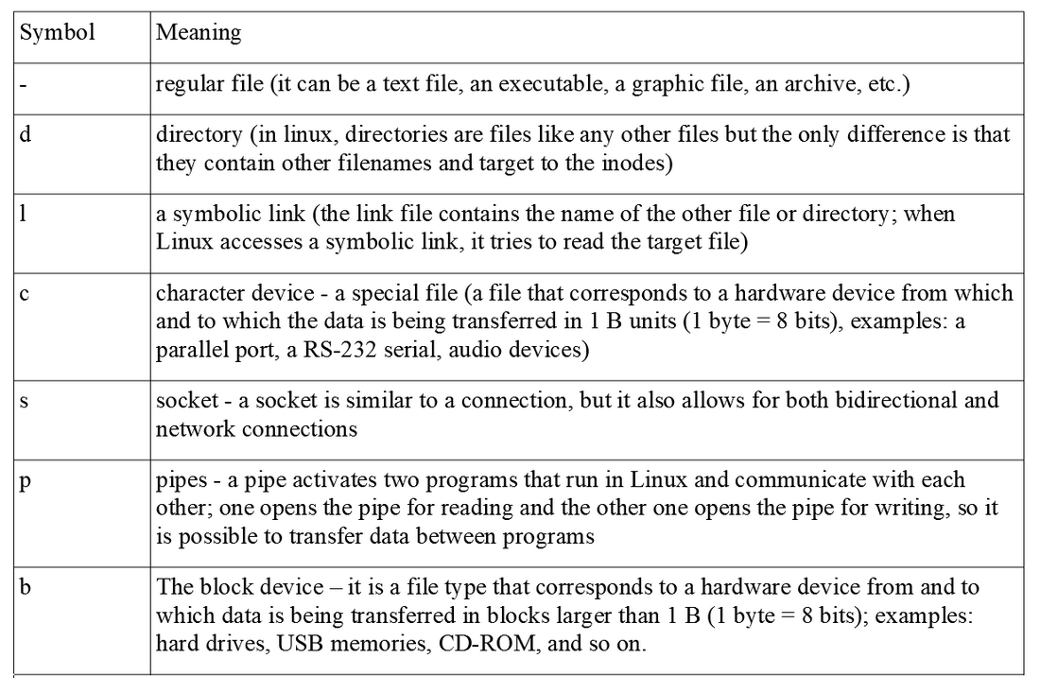
Useful Symbols for Files
www.lpu.in Lovely Professional University
59

Slide 60
Types of File Systems
Following are the various file systems in a device:
FAT – File Allocation Table
GFS – Global File System
HFS – Hierarchical File System
DFS – Distributed File System
UDF -
Extended file system
NTFS – New Technology File System
www.lpu.in Lovely Professional University
60

Slide 61
FAT File System
FAT32
Full form is file allocation table
One of the oldest file systems available on the windows machine.
Introduced on ms-dos 7.1 / windows 95 in 1996
Developed for floppy disks but later used on hard drive, USB flash drives, and SSD cards.
Until windows xp, it was default file system
FAT8, FAT12, and FAT16, FAT32 are its variations.
Structure of FAT32 File
www.lpu.in Lovely Professional University
61

Slide 62
FAT32 contd..
Advantages:
Can hold up to 268,173,300 files
The backup FAT table copy gets automatically relocated to the root folder in FAT32 systems, which further can be used for the restoration of files.
Drive sizes are between 2 and 16 tb with 64kb clusters.
Is the official format for sd and sdhc cards.
Limitations:
Each file can have a maximum size of 4GB (GigaBytes).
No control over file permissions and data security.
The native disk’s maximum disk size for FAT32 is 32 GB. It is possible to expand it up to 2TB.
FAT32 is no longer used on modern, internal Windows hard drives as most systems have adopted the NTFS standard.
www.lpu.in Lovely Professional University
62

Slide 63
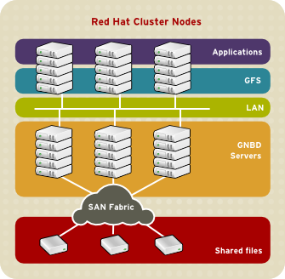
GFS File System
Full Form is Global File System
Is cluster of files that are shared between a number of computers and end systems from which data or services are accessed, stored and fetched.
A GFS reads and writes to the remote device
GFS Overview
www.lpu.in Lovely Professional University
63

Slide 64
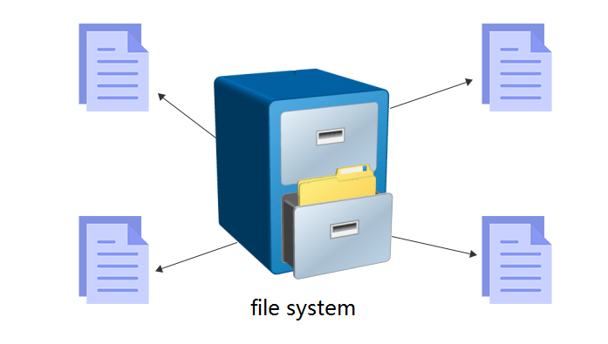
NTFS (New Technology File System)
NTFS:-
Current Windows versions beginning with Windows XP — use the NTFS file system to partition their code.
It is possible to format external drives with either FAT32 or NTFS.
www.lpu.in Lovely Professional University
64

Slide 65
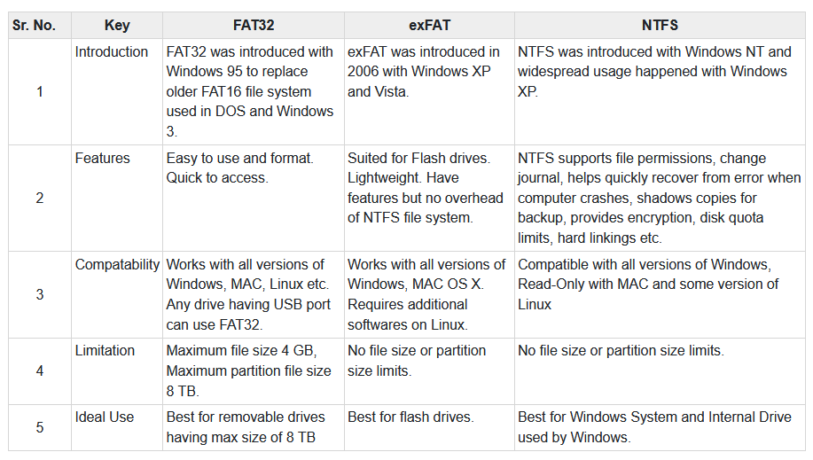
Differences between FAT32, exFAT, and NTFS File Systems.
www.lpu.in Lovely Professional University
65

Slide 66
HFS File System
A file with the HFS file extension is an HFS disk image file.
Known as Hierarchical File System
Used to store the files on floppy disks, CD-ROM discs, and hard drives of older Apple Macintosh computers.
www.lpu.in Lovely Professional University
66

Slide 67
Btrfs
Btrfs — "better file system" — is a newer, still in development, Linux file system.
It is a copy-on-write (CoW) filesystem.
The goal is to provide additional features that allow Linux to scale up to larger storage amounts.
www.lpu.in Lovely Professional University
67

Slide 68
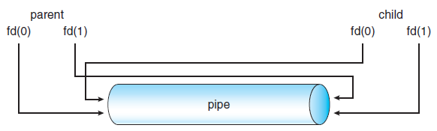
Concept of Pipes and Redirection
A pipe is a connection between two processes, such that the standard output from one process becomes the standard input of the other process.
In UNIX Operating System, Pipes are useful for communication between related processes(inter-process communication).
Although pipe can be accessed like an ordinary file, the system actually manages it as FIFO queue.
www.lpu.in Lovely Professional University
68

Slide 69
Concept of Redirection
Redirection is for files (you redirect streams to/from files).
One common need when we run applications is to direct the output into a file instead of the terminal. A redirect sends a channel of output to a file.
This is typically done with the > operator between the application to run and the file to write the output into. For example, we can send the output of the ls command into a file called files as follows:
$ ls > files
www.lpu.in Lovely Professional University
69

Slide 70
Searching the File System
Use command- find
It search for files in a directory hierarchy under Linux and all other UNIX like operating systems.
Examples:
find . - name thisfile.txt. ...
find /home -name *.jpg. Look for all . ...
www.lpu.in Lovely Professional University
70

Slide 71
Searching the File System contd..
Use command- grep
Grep is an acronym that stands for Global Regular Expression Print.
The grep command searches through the file, looking for matches to the pattern specified.
Grep is case-sensitive.
Example:
grep myname biodata
Here biodata is file and myname is specific pattern for searching in biodata file
www.lpu.in Lovely Professional University
71

Slide 72
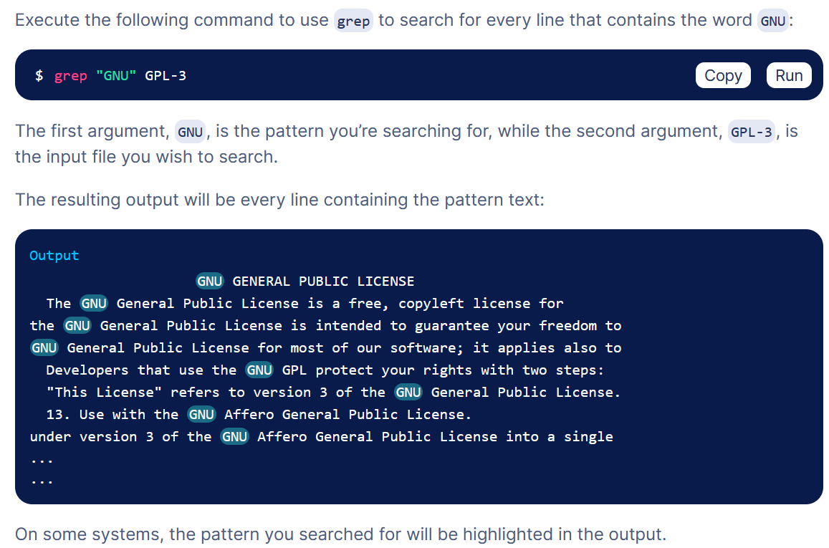
Use of grep
www.lpu.in Lovely Professional University
72

Slide 73
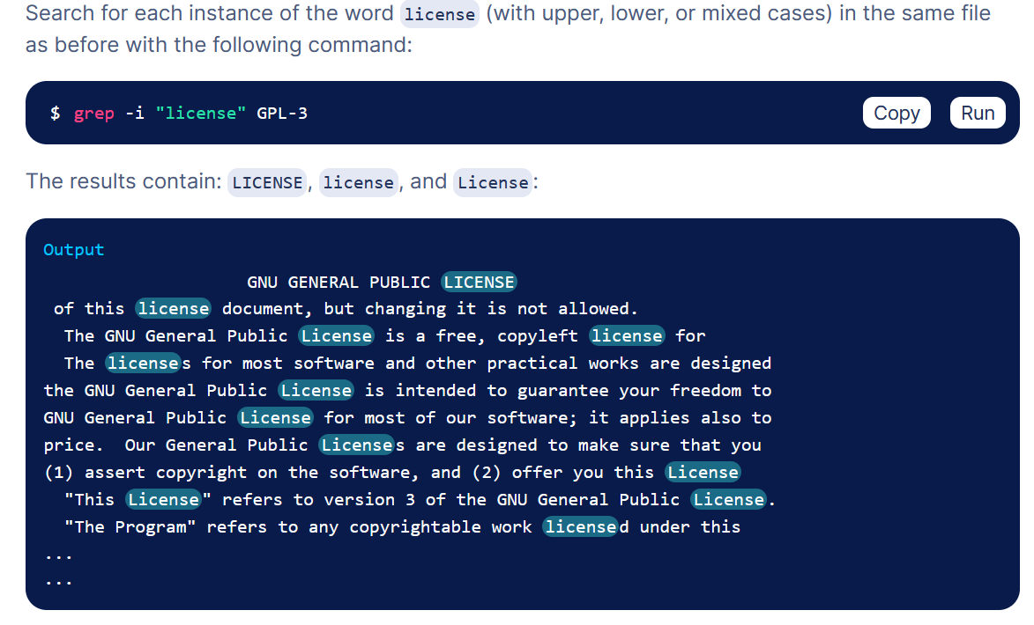
Use of grep contd..
www.lpu.in Lovely Professional University
73

Slide 74
Process Signals
A signal is basically a one-way notification.
A signal can be sent by the kernel to a process, by a process to another process, or a process to itself.
Signals are one of the ways process communicate among themselves and with the kernel.
The list of the most commonly used signals follow:
SIGTERM: Surprisingly, the default signal sent by kill command.
Asks the process to terminate voluntarily.
SIGKILL: unlike SIGTERM, forces the process to terminate.
Can't be blocked or handled.
SIGSTOP: suspend the process execution.
www.lpu.in Lovely Professional University
74

Slide 75
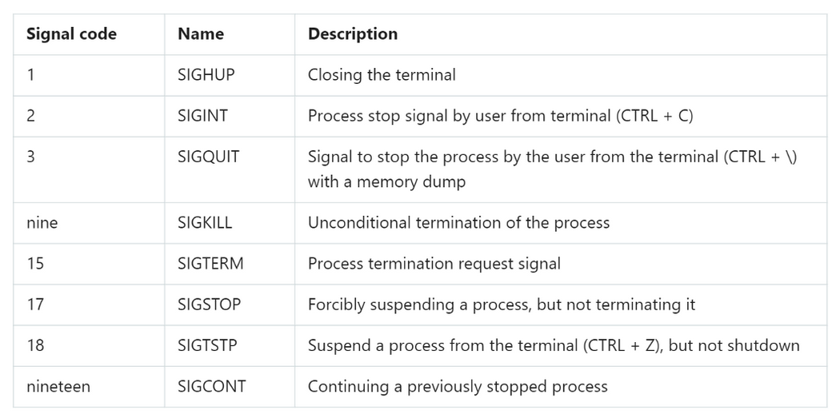
Description of Signals
www.lpu.in Lovely Professional University
75

Slide 76
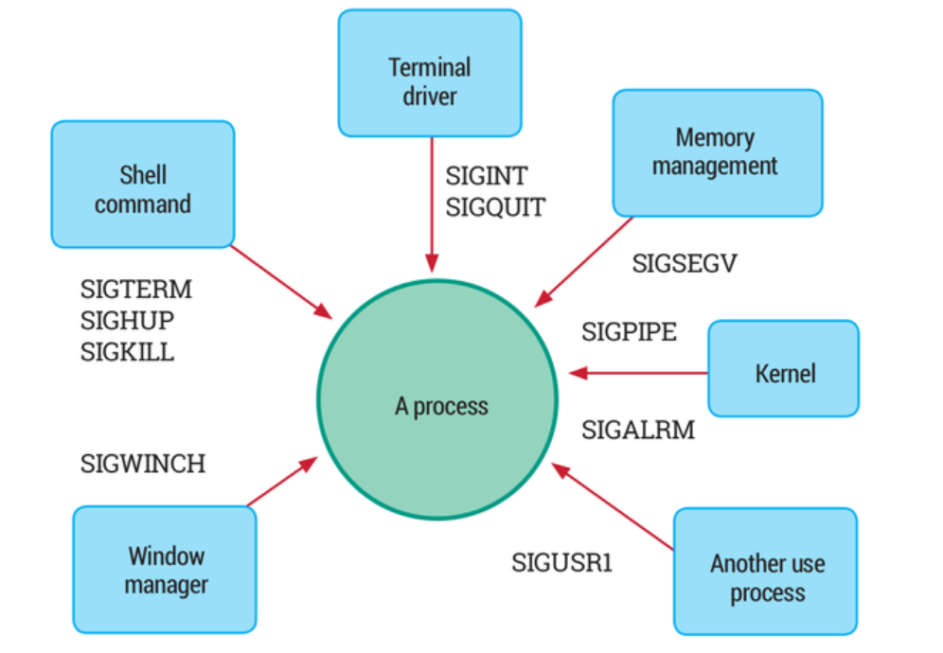
Linux Signals
www.lpu.in Lovely Professional University
76

Slide 77
Kill command
The killall is a Linux only command. It kills processes by names.
Examples:
killall {Process-Name-Here}
killall -9 {Process-Name-Here}
killall -15 {Process-Name-Here}
kill the process using a PID (Process ID)
# kill 3486
PID can be searched using pgrep command
www.lpu.in Lovely Professional University
77

Slide 78
Path Variable
It displays or set a search path for executable files at the command line.
Syntax PATH pathname [;pathname] [;pathname] [;pathname]... PATH PATH ; Key pathname : drive letter and/or folder ; : the command 'PATH ;' will clear the path PATH without parameters will display the current path.
The %PATH% environment variable contains a list of folders.
The PATH variable is an environment variable containing an ordered list of paths that Linux will search for executables when running a command.
For example, if we want to print Hello, world! in Bash, the command echo can be used rather than /bin/echo, so long as /bin is in PATH:
www.lpu.in Lovely Professional University
78

